Slide 1
Introduction to Linux operating system

Slide 2




Operating system?
An operating system (OS) is system software that manages computer hardware, software resources, and provides common services for computer programs
Hardware Management (motherboard, RAM, Processor, Hard disk)
Memory Management
Managing Multitasking
Managing Multiple users
Process management
Users
Application
Operating systems
Hardware

Slide 3
linux
Linux is a set of open source operating systems.
Its as simple as that just like windows and mac.
Linux based OS provide us an interface to use specific programs with help of the hardware.
functionality list is quite like UNIX.
Opensource
Distribution
History of linux
Linus Torvalds the creator of linux (1990s)
Wrote his own unix-like operating system.

Slide 4




Various linux Distributions
RED HAT ENTERPRISE LINUX
FEDORA
DEBIAN
UBUNTU
OTHER

Slide 5
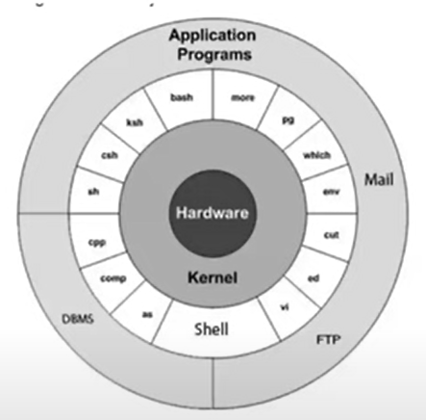
Architecture
Hardware
Kernel(program)
Shell(program) –command line interface
Commands
File and directories (folder)

Slide 6
Types of users
Root user
One root user
Root user can run all the which is present in :- user/sbin
Symbol of root user #
Non root user
More then one root user
Non-root user can run only limited command which is present in :- usr/bin (directory)
Symbol of root user $

Slide 7
Components and Basic features of Linux System
Kernel
Kernel is the core part of Linux.
It is responsible for all major activities of this operating system.
It is consisting of various modules and it interacts directly with the underlying hardware.
Kernel provides the required abstraction to hide low level hardware details to system or application programs.
• Monolithic Kernel • Micro kernels • Hybrid kernels
System Library:
System libraries are special functions or programs using which application programs or system utilities accesses Kernel's features. These libraries implement most of the functionalities of the operating system and do not require kernel module's code access rights.
System Utility:
System Utility programs are responsible for doing specialized, individual level tasks.

Slide 8
Portable
Open Source
Multi-User
Multiprogramming
Hierarchical File System

Slide 9
VPN
Virtual Private Network

Slide 10
Virtual Private Network
Virtual private networks (VPNs) to create end-to-end private network connections.
A VPN is virtual in that it carries information within a private network, but that information is actually transported over a public network.
A VPN is private in that the traffic is encrypted to keep the data confidential while it is transported across the public network.

Slide 11
Site-to-Site VPN
A site-to-site VPN is terminated on VPN gateways. VPN traffic is only encrypted between the gateways. Internal hosts have no knowledge that a VPN is being used

